Slide 1
A Data Analysis On The Impact of Gentrification
Sam DeWitt, Deiva Ganabathy, Tasha Peeples, Sara Simons, Jonathan Yang

Slide 2
Background
Location: Michigan Counties (Oakland, Kent, Saginaw, and Muskegon)
Focus: Comparing and analyzing two seemingly more gentrified counties with two less gentrified counties.
Primarily focus on the measures that help show/predict communities at risk of being or already gentrified and determine correlation.
In our research we determined quantitative studies have focused on income as a primary variable among several others
Computing statistical significance across multiple possible variables and how they may be either negatively or positively affecting the community.

Slide 3
Purpose & Scope
Purpose:
Predict communities at risk of gentrification
Adjusted Median Income
Home Values
Rent Prices
Demographics (Population, Unemployment, Poverty Rates, Education, etc.)
Further explore and analyze additional variables and their correlation (negative or positive) with gentrification.
Scope:
Our analysis and data collection focuses on four counties.
We classified Oakland County and Kent County as gentrified/gentrifying counties and Muskegon County and Saginaw County as less or non-gentrified counties.

Slide 4
Hypothesis
We believe areas undergoing higher levels of gentrification will exhibit lower infant mortality rates, higher rent rates, increased home values, and a shift in demographics towards a more diverse population.
Gentrification is expected to contribute to improved economic conditions and healthcare accessibility, potentially influencing both demographic and housing indicators in these neighborhoods

Slide 5
Methods
Pull Census Data from Python Wrapper for Census API: 2011 - 2020
Inflate all financial variables to 2023 dollars with cpi inflate module
Pulled the multiple data frames into a data set and pulled / merged data from them as we broke down our variables
Used different charting styles to visually represent our findings

Slide 6
Gentrification vs Adjusted Median Income

Slide 7
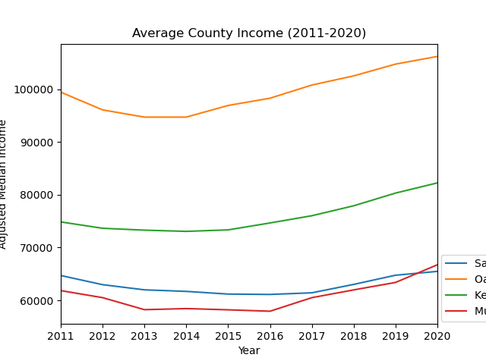
Gentrification vs Average Median Income

Slide 8
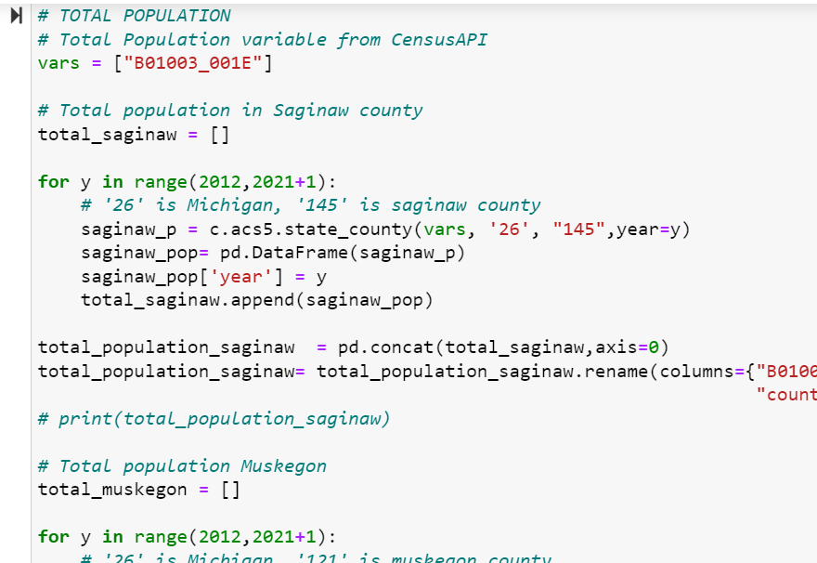
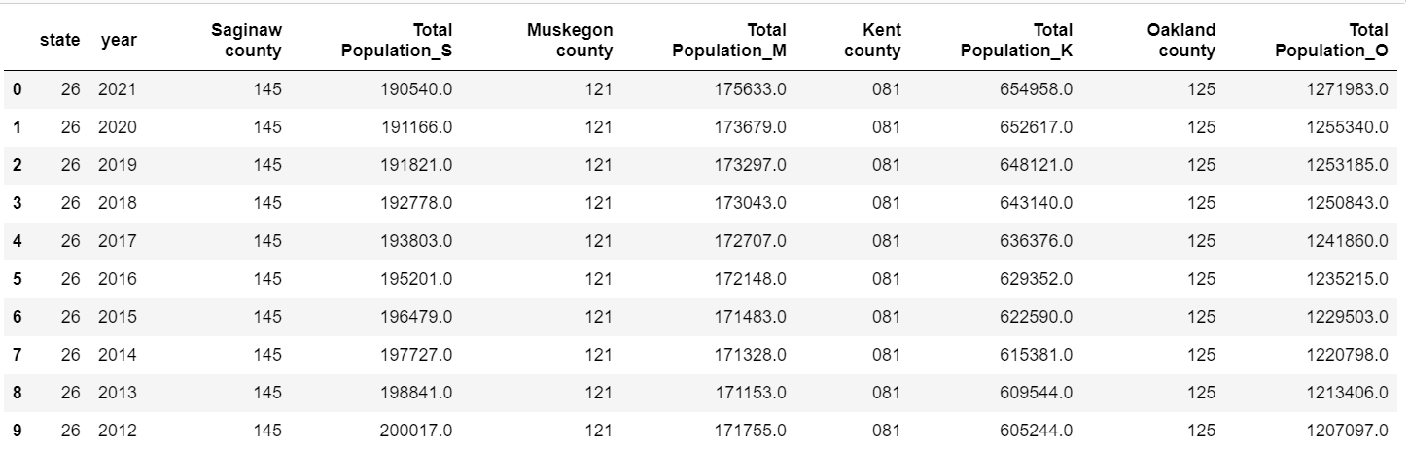
Gentrification & Total Population
Question: Is there a correlation between increased gentrification and total population?

Slide 9
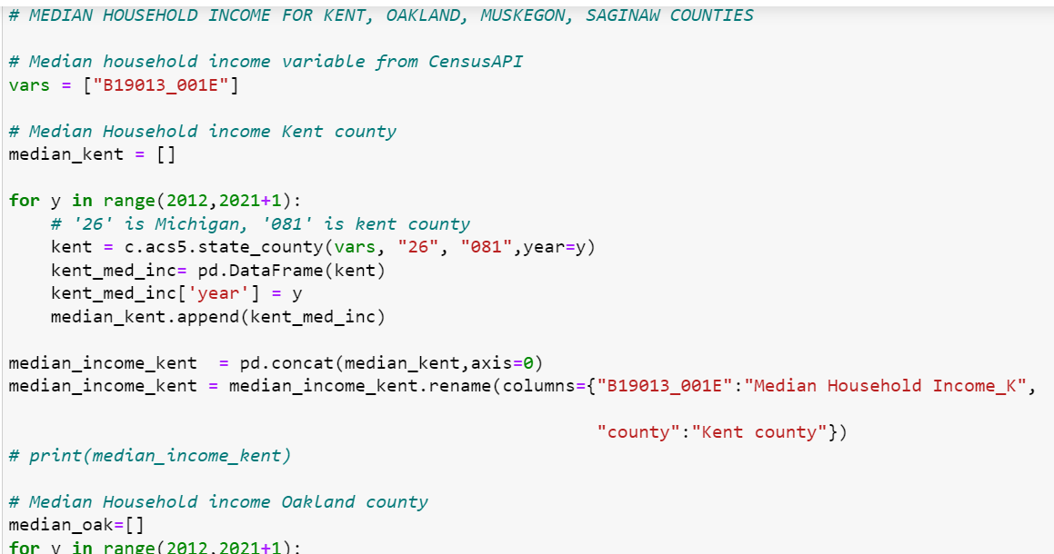
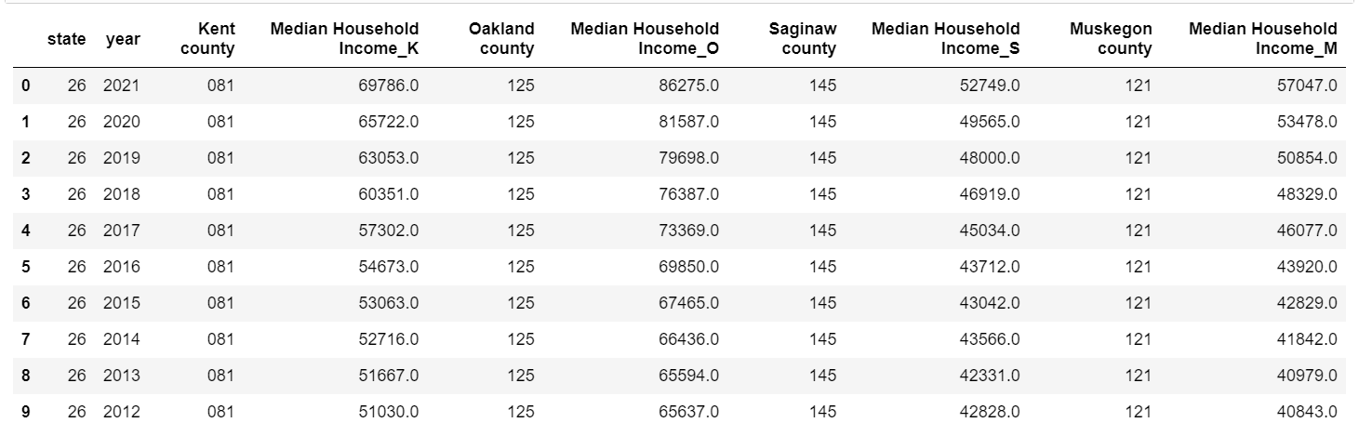
Gentrification & Median household income
Question: Is there a correlation between increased gentrification and total population?

Slide 10
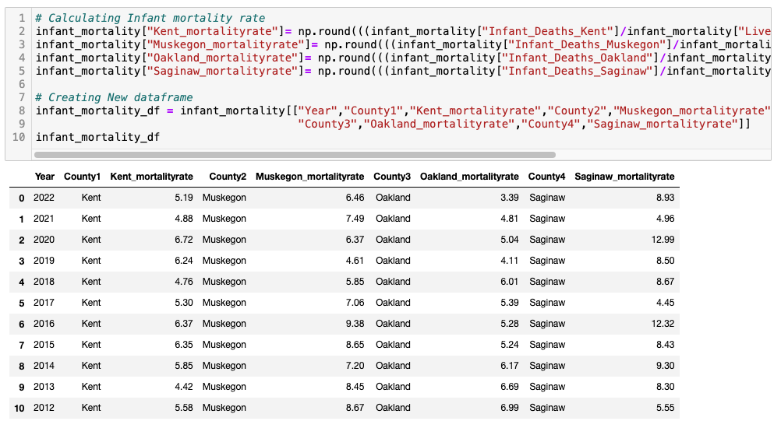
Gentrification & Infant Mortality
Question: Is there a correlation between increased gentrification and infant mortality rates?

Slide 11
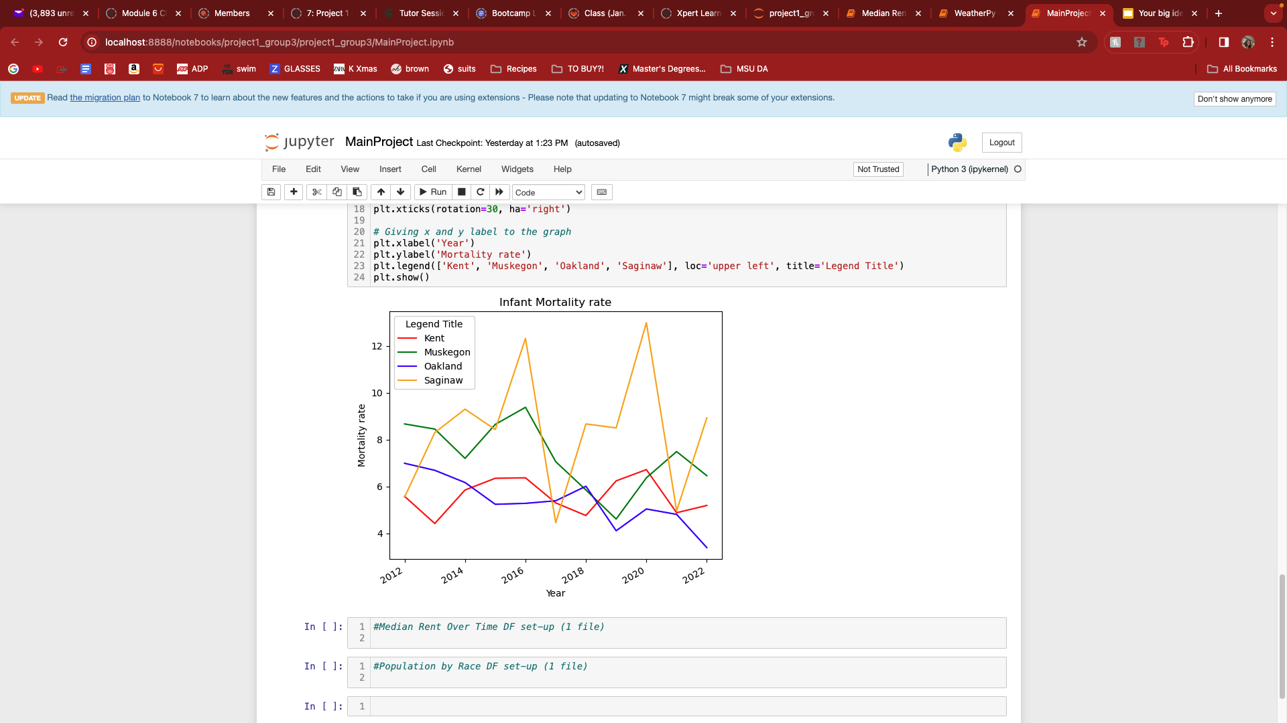
Gentrification & Infant Mortality
Question: Is there a correlation between increased gentrification and infant mortality rates?
Answer: Infant mortality is influenced by many factors. However, highly gentrified areas have lower infant mortality rates.

Slide 12
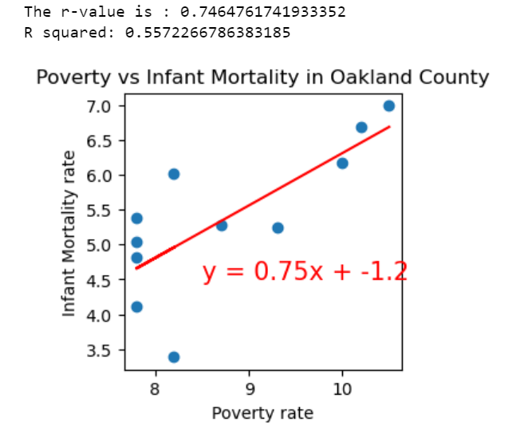
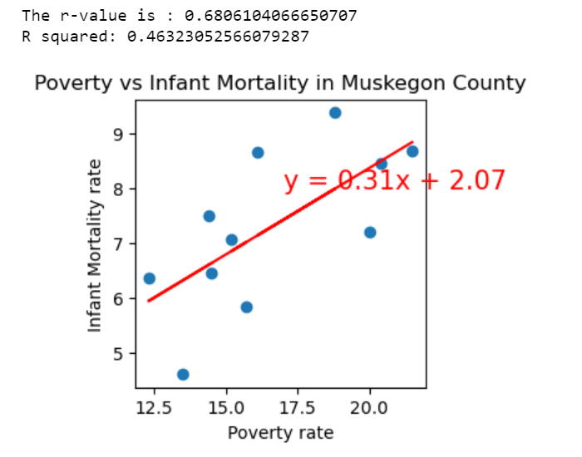
Gentrification: Poverty Vs Infant mortality
The influence of gentrification over poverty has a positive correlation with the infant mortality rate.

Slide 13
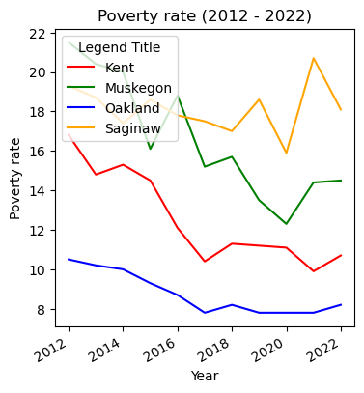
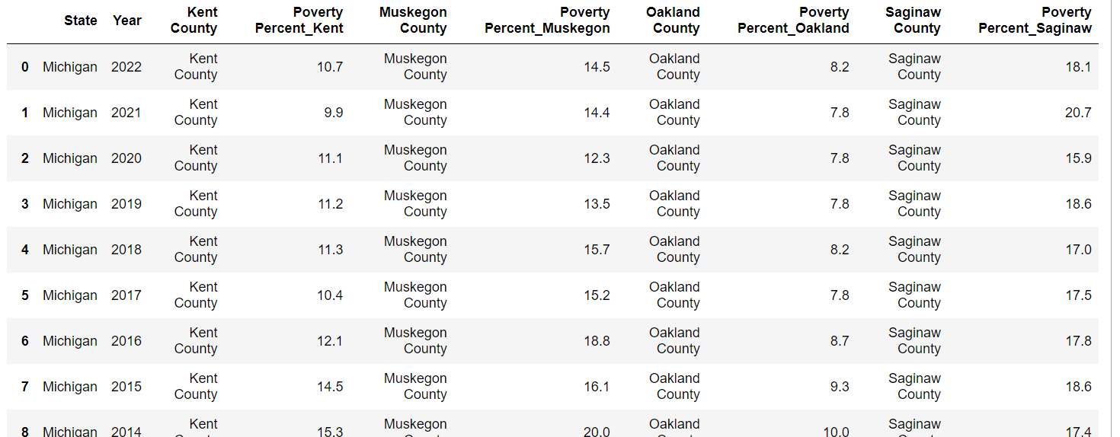
Gentrification & Poverty rate
Question: Is there a correlation between increased gentrification and poverty rate?
Answer: Yes.
.

Slide 14
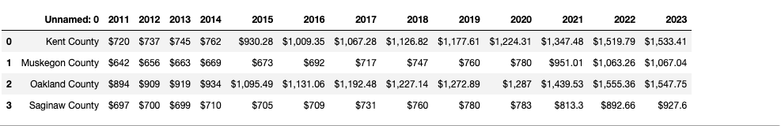
Gentrification & Average Rent Rate
Question: Is there a correlation between increased gentrification and the rent rate?

Slide 15
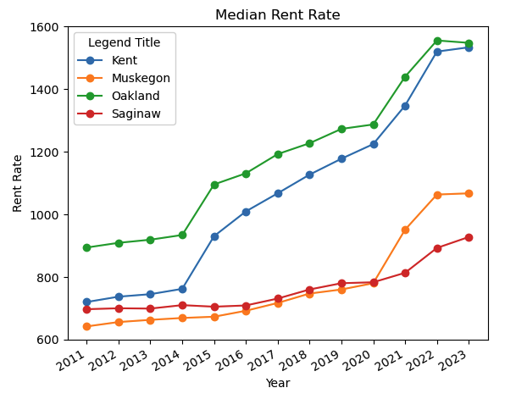
Gentrification & Average Rent Rate
Question: Is there a correlation between increased gentrification and the rent rate?
Answer: Yes!
Notes:
Notable Features:
Significant hike in rent rate {2015}
More rapid rate increase
Much greater rate difference {2011 vs 2023}

Slide 16
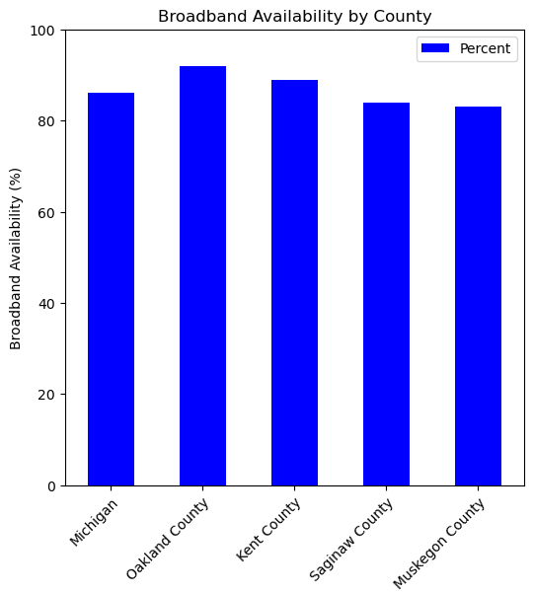
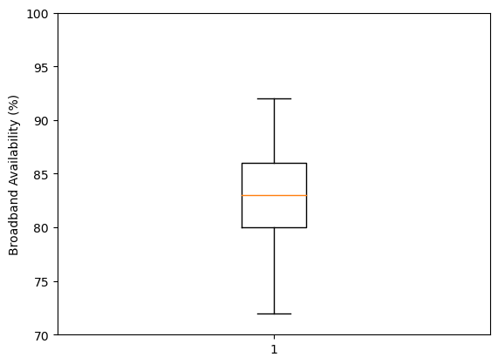
Gentrification & Broadband Availability
Question: How does access to a household Broadband internet connection vary across our survey range, and how does it compare to state averages?
Answer: It’s not particularly variable across our selected data range.
Michigan Population Avg: 86% | County Avg: 82.79 | Median: 83.0% | Std Dev: 4.39

Slide 17
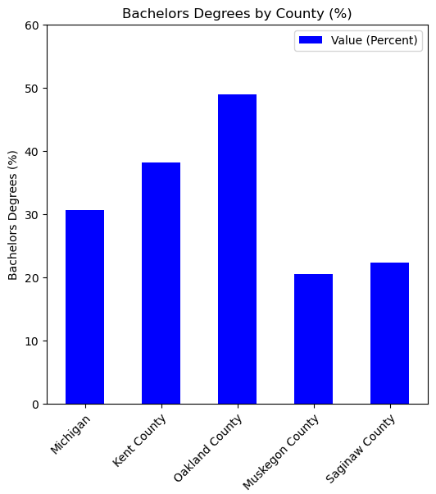
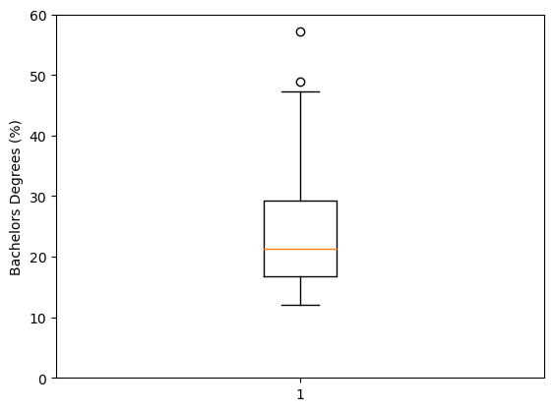
Gentrification & Education
Question: How do rates of college graduation (Bachelor’s degree) vary across our sample?
Answer: We see a fairly significant difference between counties surveyed, with Oakland being an outlier from the state population.
Michigan Population Avg: 30.6% | County Avg: 23.62% | Med: 21.3% | Std Dev: 23.62

Slide 18
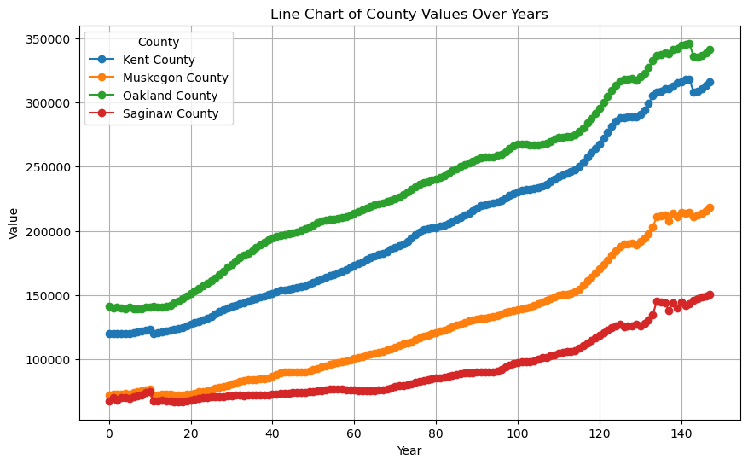
Gentrification & Home Values
Question: Can home prices identify signs of gentrification?
Answer: Increasing home value can be a sign of gentrification in areas where home prices have been historically lower.
However, it doesn’t necessarily mean that gentrification is occurring within the neighborhood based purely on home prices; other variables would need to be considered.

Slide 19
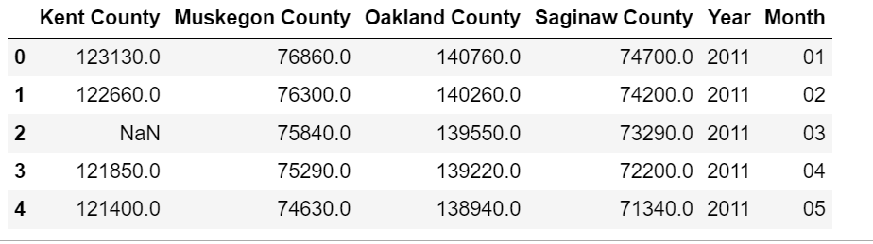
Gentrification & Home Values
Taking four local areas; Kent, Muskegon, Oakland, and Saginaw counties, our data reflects that housing prices have increased year over year. So if we were just looking at housing prices as a sign of gentrification that couldn’t be determined by our research.

Slide 20
Summary/ Closing Remarks
In summary, although "gentrification" proves challenging to precisely define and empirically observe, our analysis reveals that counties we initially perceived as more gentrified or undergoing rapid gentrification (Oakland and Kent) exhibit elevated average incomes, higher growth rates of home values, increased rental rates, higher educational attainment, and lower poverty rates compared to our alternative pair of counties (Muskegon and Saginaw.)
Muskegon shows signs of gentrification surpassing Saginaw, with faster increases in home values and a sharper decline in infant mortality. Oakland, outscoring Kent on various metrics, could be deemed more gentrified by our project's standards.

Slide 21
Sources
HDPulse: An Ecosystem of Minority Health and Health Disparities Resources. National Institute on Minority Health and Health Disparities. Created 2/7/2024. Available from https://hdpulse.nimhd.nih.gov
Source: Demographic data provided by the Census Bureau (http://www.census.gov/) & the American Community Survey (http://www.census.gov/acs/www/)
Community Health Information--Natality (michigan.gov)
https://mihousingdata.org/data_portal
https://dev.hra-dashtest.com/report/64fb7b32350fb3dad490b8e9/26081/home#64b5586cef3e47398d8867cf

Slide 22
Thank You!
any questions?

